Slide 1


Department of Artificial Intelligence and Data Science
Project Work Phase – I
Zeroth Review
A Hybrid Multi-Modal Framework for
Effective Prediction of Liver Diseases
Batch Members:
Mugesh Kumar M - 727823TUAD101
Rohit T J – 727823TUAD129
Roshan S – 727823TUAD130
Batch No.: 1
Supervisor: Ms. R Kalaivani
Date: 19/06/2026 (AN)

Slide 2

Problem Statement
01
02
03
Silent Progression
Black-Box AI
Modality Isolation
NAFLD progresses silently through stages of steatosis and fibrosis, often undetected until advanced. Liver diseases (cirrhosis, hepatitis, HCC) are similarly diagnosed late, limiting treatment options.
Existing AI models achieve high accuracy but lack explainability — clinicians cannot trust predictions without understanding the clinical reasoning.
Current models process ultrasound or CT/MRI images OR blood tests in isolation, failing to exploit complementary information between imaging and biochemical markers.
Objective: Build a multimodal, multi-task, explainable AI framework for NAFLD detection and fibrosis staging from paired ultrasound imaging and clinical blood tests, with clinical trust.

Slide 3
Objectives
Contrastive Pre-training
Cross-Modal Fusion
Multi-Task Learning
01
02
03
Use SimCLR to self-supervise a Swin-CNN encoder on unlabeled NAFLD ultrasound images (10,352 images from 384 patients) before fine-tuning — extracting robust visual representations.
Fuse imaging (Swin-CNN) and tabular clinical data (FT-Transformer) via bidirectional cross-attention for dynamic per-patient weighting.
Jointly predict: (a) NAFLD detection (Normal vs Diseased), and (b) fibrosis stage (F0–F3) using shared backbone with task-specific heads.
Counterfactual XAI
Uncertainty Quantification
Clinical Dashboard
04
05
06
SimCLR on 10,352 unlabeled NAFLD ultrasound slices — liver-specific visual priors instead of generic ImageNet weights.
Flag low-confidence predictions using Monte Carlo Dropout (10 forward passes) for human-in-the-loop clinical safety review.
Build a Streamlit/Gradio interface showing scan overlays, SHAP charts, and counterfactual cards for clinician decision support.

Slide 4
Literature Survey & Technology Gap
Method / Paper
Approach
Limitation / Gap
XAIHO (Springer 2025)
ResNet-50 + SHAP + Adam — 92.35% accuracy
Single modality; no cross-modal fusion; post-hoc SHAP lacks counterfactuals
BiLSTM-AM-VMD (2025)
Multimodal BiLSTM + attention, AUC 0.963 for HCC
Feature concatenation (not cross-attention); no uncertainty; SHAP-only
NMD-FusionNet (2025)
CT + multi-window fusion for liver cancer segmentation
Segmentation-only; no tabular integration; no predictive staging
Self-Supervised SNN (2025)
SimCLR-based Siamese Net — 99.90% on ultrasound
Single modality; no tabular fusion; minimal explainability
FL-XAI (2025)
Federated Learning + Random Forest / XGBoost + XAI
Ensemble ML only; no imaging modality; no multi-task prediction
Research Gap: No existing work combines contrastive pre-training + cross-modal attention + multi-task learning + counterfactual XAI in a single hepatology framework.

Slide 5
Proposed Methodology: CMCHT-XAI
Cross-Modal Contrastive Hybrid Transformer with Counterfactual Explainable AI
Input Layer
Imaging Encoder
Tabular Encoder
Cross-Modal
Attention
Multi-Task
Heads
XAI Layer
NAFLD Ultrasound
B-mode + Tabular Clinical Data
Swin-CNN Hybrid
(SimCLR
Pre-trained)
FT-Transformer
(Feature Tokenizer)
Bidirectional
Multi-Head
Cross-Attention
NAFLD Detection
(Binary) Fibrosis Staging (Multi-class)
SHAP+GradCAM
+Counterfactuals
+Uncertainty
★
★
★
Contrastive Pre-training
Counterfactual XAI
Uncertainty Quantification
SimCLR on unlabeled liver images — liver-specific visual priors instead of generic ImageNet weights.
DiCE generates actionable "what-if" patient-level recommendations for clinical decision support.
Monte Carlo Dropout (10 forward passes) flags ambiguous predictions for human review.

Slide 6
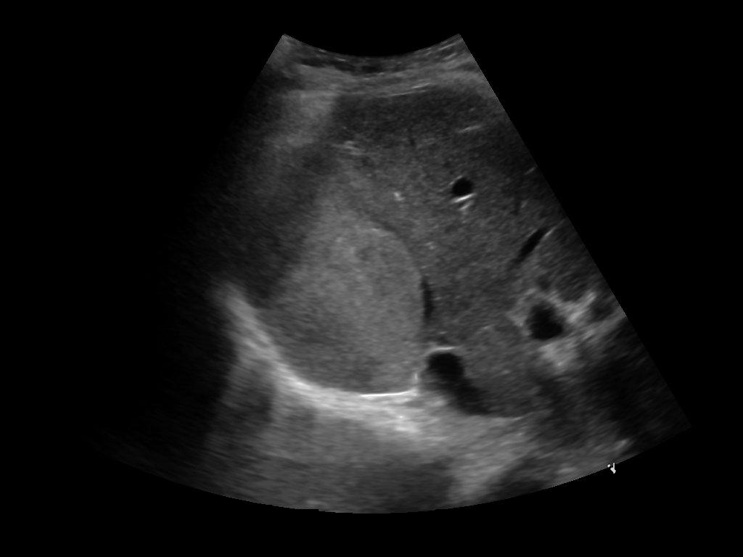
Datasets
Legal Open-Source Datasets
Sample Datasets
Dataset | Type | Size | License | Access Link
ILPD (Indian Liver Patient Dataset) | Tabular (blood tests: bilirubin, SGPT, SGOT, albumin, etc.) | 583 patients (416 diseased, 167 healthy) | Public / UCI Repository | ILPD (Indian Liver Patient Dataset) - UCI Machine Learning Repository
BUPA Liver Disorders | Tabular (7 biochemical features) | 345 instances | Public / UCI Repository | Liver Disorders - UCI Machine Learning Repository
NAFLD Ultrasound + Clinical (Mendeley) | CT Volumes + Segmentation masks | 201 CT scans (131 train, 70 test) | CC BY-NC-SA (non-commercial) | Dataset on NAFLD Severity Classification with Ultrasound Liver Image & Clinical Data - Mendeley Data
NAFLD Ultrasound + Clinical provides paired imaging and tabular data for the same 384 patients, enabling true cross-modal fusion without synthetic alignment. ILPD and BUPA serve as supplementary tabular benchmarks.

Slide 7
Implementation Roadmap
Phase 1
Wk 1–3
Phase 2
Wk 4–6
Phase 3
Wk 7–12
Environment & Data
Self-Supervised Pre-training
Hybrid Model Development
Setup PyTorch/MONAI, Download NAFLD Ultrasound + Clinical (Mendeley); ILPD as supplementary tabular benchmark. Preprocessing (resample, augment, SMOTE)
SimCLR on unlabeled NAFLD ultrasound slices (10,352 images), NT-Xent loss, Evaluate representations on 10% labeled data
Swin-CNN + FT-Transformer, Cross-Modal Attention Fusion, Multi-Task training (AdamW + Focal Loss)
Phase 4
Wk 13–15
Phase 5
Wk 16–18
Phase 6
Wk 19–20
XAI & Uncertainty
Evaluation & Ablation
Documentation & Submission
SHAP + Grad-CAM + DiCE counterfactuals, MC Dropout (10 passes), Clinical dashboard (Streamlit)
AUC-ROC, F1 (macro), Stage Accuracy, ECE metrics — ablation: remove pre-training / fusion / multi-task / uncertainty
Jupyter notebooks, Model weights (.pth), IEEE paper draft, Project report

Slide 8
Expected Outcomes & Deliverables
>90%
>0.85
>80%
<0.10
Detection AUC-ROC
Staging F1 (macro)
Fibrosis Stage Accuracy
Expected Calibration Error
(NAFLD Detection)
Multi-class fibrosis
Multi-class staging
Uncertainty quality
Final Deliverables
✓
Executable Jupyter notebooks and Python scripts for end-to-end pipeline
✓
Trained model weights (.pth) for all components
✓
Clinical Streamlit dashboard with Grad-CAM, SHAP charts, and counterfactual cards
✓
Journal paper draft with ablation study tables
✓
Technical project report with full methodology and results
✓
Ablation: contrastive pre-training vs random init, cross-modal vs concatenation, multi-task vs single-task

Slide 9
References
No. | Authors | Title | Venue / Source | Year | Category | Type | Key Contribution / Relevance
1 | Bhardwaj, S., et al. | Transformer-enhanced deep ensemble for multi-class liver disease classification using computed tomography images | Scientific Reports (Springer) | 2025 | Imaging Classification | Applied | Hybrid CNN-Transformer ensemble (ResNet50V2, DenseNet121, MobileNetV2 + Transformer) achieving 97% accuracy on CT liver classification (fatty liver, cirrhosis, HCC).
2 | Wei, et al. | Liver Lesion Network (LiLNet) deep CNN | Radiology/AI | 2024 | Imaging Classification | Applied | 6-class liver lesion classification (HCC, ICC, MET, FNH, HEM, CYST) with ACC = 94.7%, AUC = 97.2%.
3 | Midya, et al. | Modified Inception-v3 for liver tumor classification | Biomedical Signal Processing | 2023 | Imaging Classification | Applied | 4-class classification (HCC, ICC, CRLM, Benign) with 96% accuracy.
4 | Various (XAIHO Framework) | Explainable AI Leveraging Hybrid Optimized Framework for Liver Cirrhosis Detection | Springer | 2025 | Explainability | Applied | ResNet-50/VGG16 + SHAP + Adam optimizer, 92.35% accuracy for cirrhosis staging.
5 | Various (NMD-FusionNet) | Multimodal Fusion-Based Diagnostic Model for Liver Cancer | Springer | 2025 | Multimodal Fusion | Applied | Multi-window CT fusion for liver cancer segmentation.
6 | N/A (Survey) | Explainable artificial intelligence and ensemble learning for hepatocellular carcinoma classification: State of the art, performance, and clinical implications | World Journal of Gastroenterology | 2025 | Explainability | Survey | Comprehensive survey of SHAP, LIME, Grad-CAM, and attention mechanisms for HCC. Shows how Grad-CAM highlights arterial hyperenhancement and venous washout patterns.
7 | N/A | Leveraging deep learning and explainable AI for effective liver tumor classification from CT scan images | Frontiers in Oncology | 2026 | Explainability | Applied | EfficientNetV2-S + SHAP + Grad-CAM for benign/malignant liver tumor classification. Demonstrates SHAP color masks and Grad-CAM heatmaps on CT.
8 | N/A | Explainable AI for Diagnosis and Staging of Liver Cirrhosis Using Stacked Ensemble and Multi-Task Learning | MDPI Diagnostics | 2025 | Explainability | Applied | Multi-task learning + explainability for cirrhosis staging.
9 | Mothilal, R. K., et al. | Explaining Machine Learning Classifiers through Diverse Counterfactual Explanations | ACM FAccT | 2020 | Explainability | Foundational | Foundational DiCE paper. The algorithm to use for counterfactual generation in the tabular pathway.
10 | Lundberg, S. M., & Lee, S. I. | A unified approach to interpreting model predictions | NeurIPS | 2017 | Explainability | Foundational | Foundational SHAP paper. Required citation for any SHAP-based explainability.
11 | Selvaraju, R. R., et al. | Grad-CAM: Visual explanations from deep networks via gradient-based localization | IEEE ICCV | 2017 | Explainability | Foundational | Foundational Grad-CAM paper. The standard for CNN visualization in medical imaging.
12 | N/A (Survey) | Deep learning-based uncertainty quantification for quality assurance in hepatobiliary imaging-based techniques | PMC/NIH | 2025 | Uncertainty Quantification | Survey | Surveys UQ methods in liver imaging. Discusses AHUNet framework, 2D vs 3D uncertainty overlays, and how high-uncertainty regions (red) trigger additional radiologist review.

Slide 10
Thank You
Thank You

